Slide 1
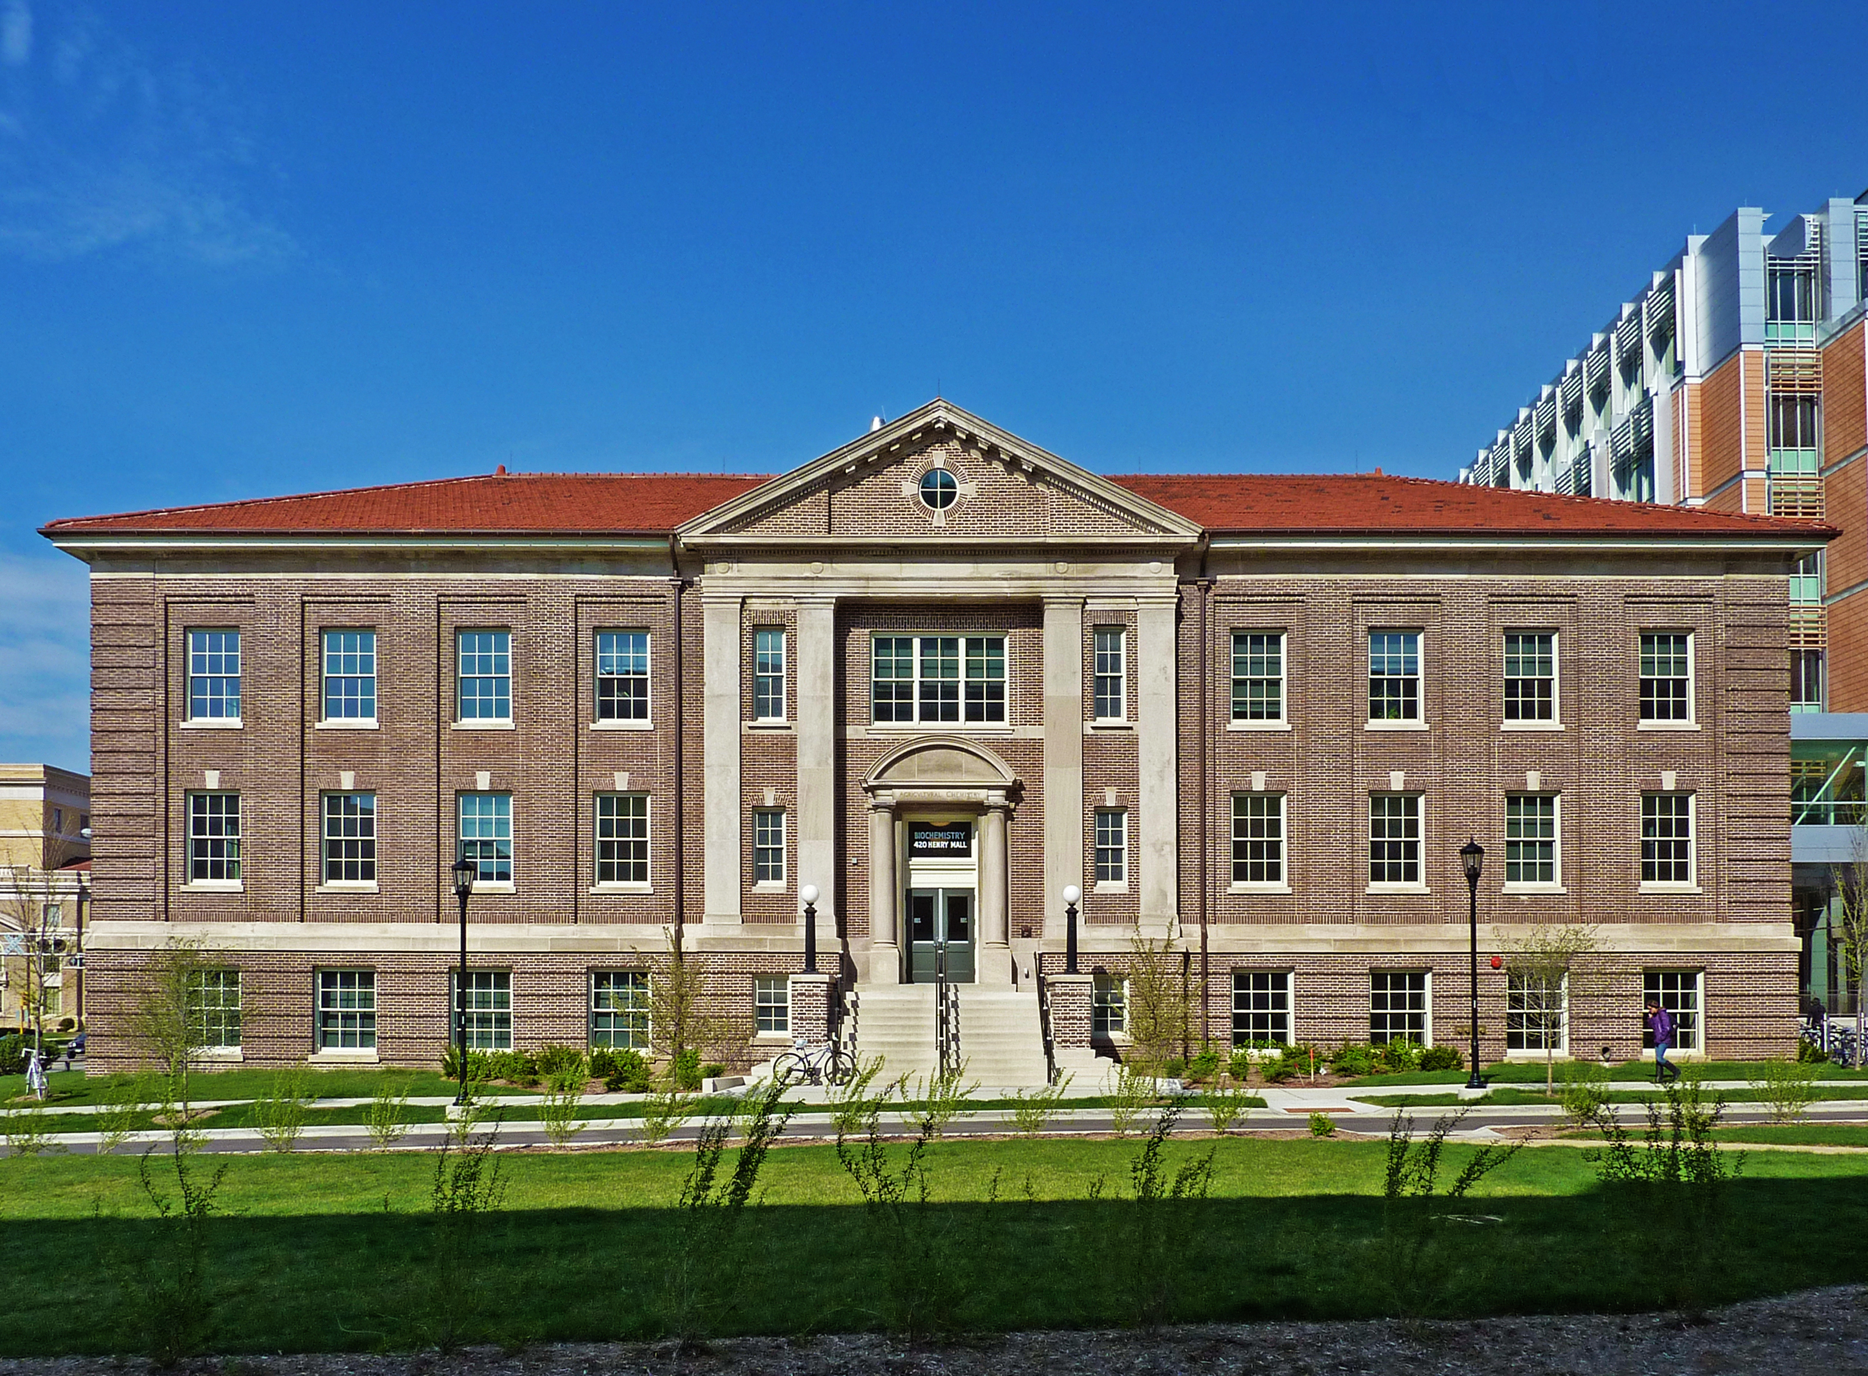
University Management System

Slide 2
Team Members
Sujan Thapa
(345342)
Raman Chaudhary
(344938)
Anish Chaudhary
(344929)

Slide 3
Introduction
UMS is a product which covers every minute aspects of a universities work flow and integrates all processes with user friendly interface.
Our project give access to register the student and teacher in the application and helps to do many works with simple use of application.
So, It will be fruitful to use as fully developed software.

Slide 4
Problem Statement
Manual and time-consuming administrative processes in universities.
Difficulty in accessing and managing student and staff information.
Inefficient communication channels between different departments.
Systems available in the market are much expensive.

Slide 5
Objective
To build the self- service systems with simple to use with little or no training.
To mobilize “University Management System” with application.
To use database for dynamically inserting & keeping records.

Slide 6
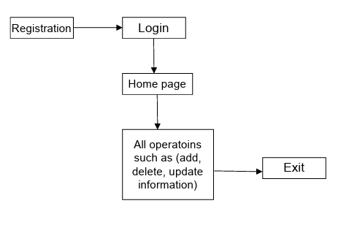
Block diagram of University Management System

Slide 7
ER Diagram

Slide 8
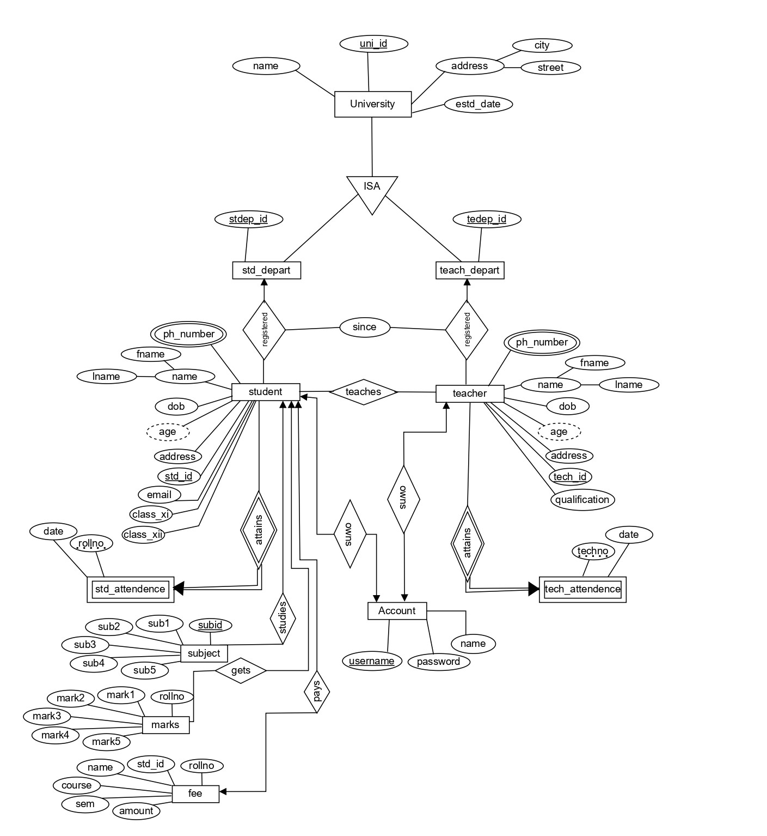

Slide 9
Flowchart

Slide 10
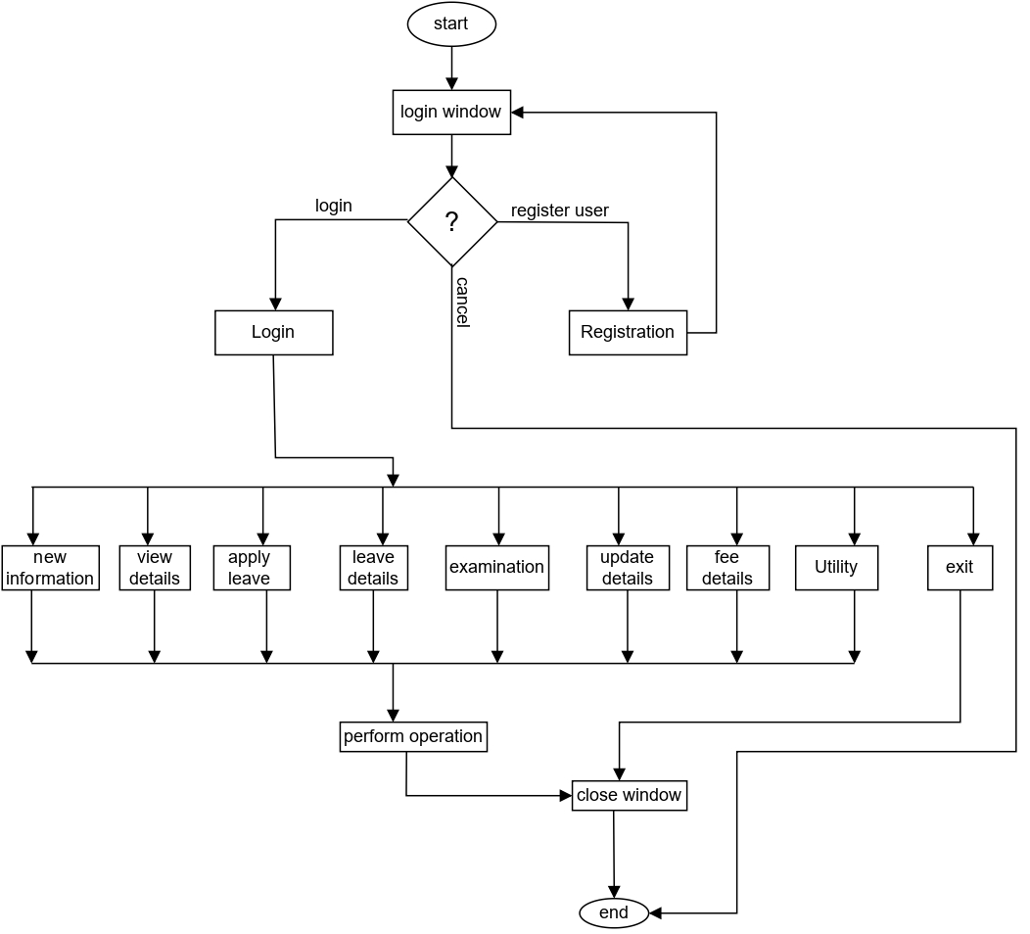

Slide 11
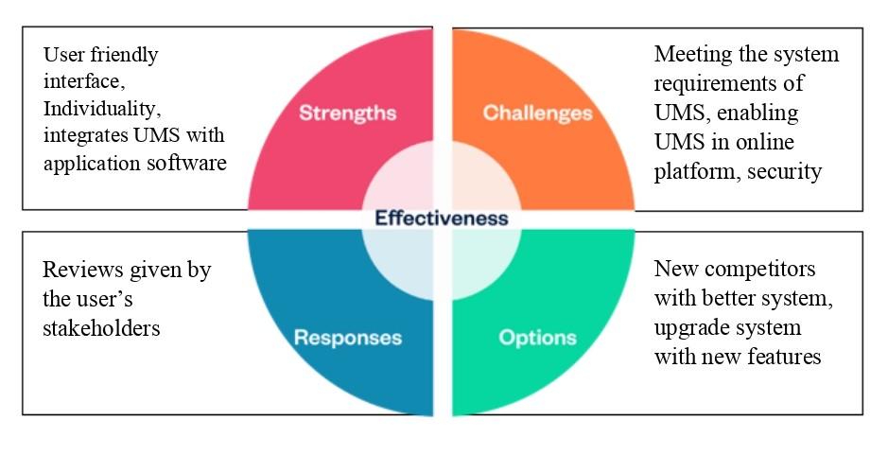
SCORE Analysis

Slide 12
Software used
NetBeans: IDE which enables us to develop desktop, mobile…,applications.
MySQL: relational db. management system which enables to create database for applications.
Windows 10, jdk.

Slide 13
Hardware used
Processor: i3 or higher
RAM: minimum 2gb
Hard drive: minimum 64gb

Slide 14
Testing of System
Testing is done on the following fields of our project:
Login
Registration
Forgot Password
Add Student, teacher
Update Student, teacher
Apply Leave and Result Sections.

Slide 15
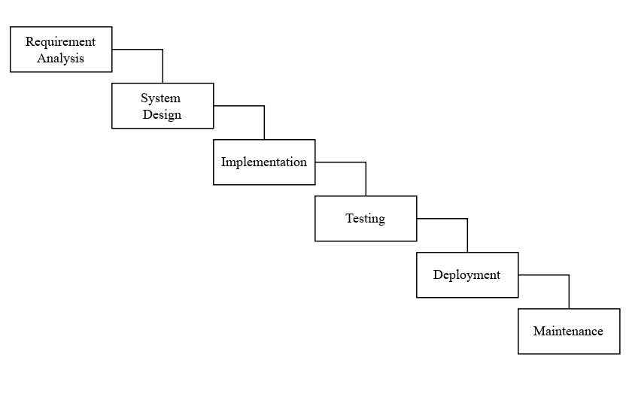
Model Used
Fig: Waterfall Model

Slide 16
Scope
In context of Nepal universities don’t have application for management they only have websites so this application can be integrate to mobilize university system in applications.
This system can be further enhanced with many essential features & use it for business purpose.

Slide 17
Further Works
We will change our desktop application to online application.
Auto transcript generation and provide it to students with application will be developed.
Fee payment will be made online by integrating application with wallets like (esewa, Khalti, etc.).
For entrance exams and any MCQ’s practice exams auto question generation by application will be developed.

Slide 18
Conclusion
Gives comprehensive solution to improve administrative workflow, student services, and data management.
Saves time of students, teachers and all other employees.
project can be expended further with many more new technologies in the future for better experience

Slide 19
Demo…

Slide 20

Thank You

Slide 21
Any Questions…

